Slide 1
ENGI 301
Homemade Roomba Proposal
2/22/2024
Nico Leibert

Slide 2
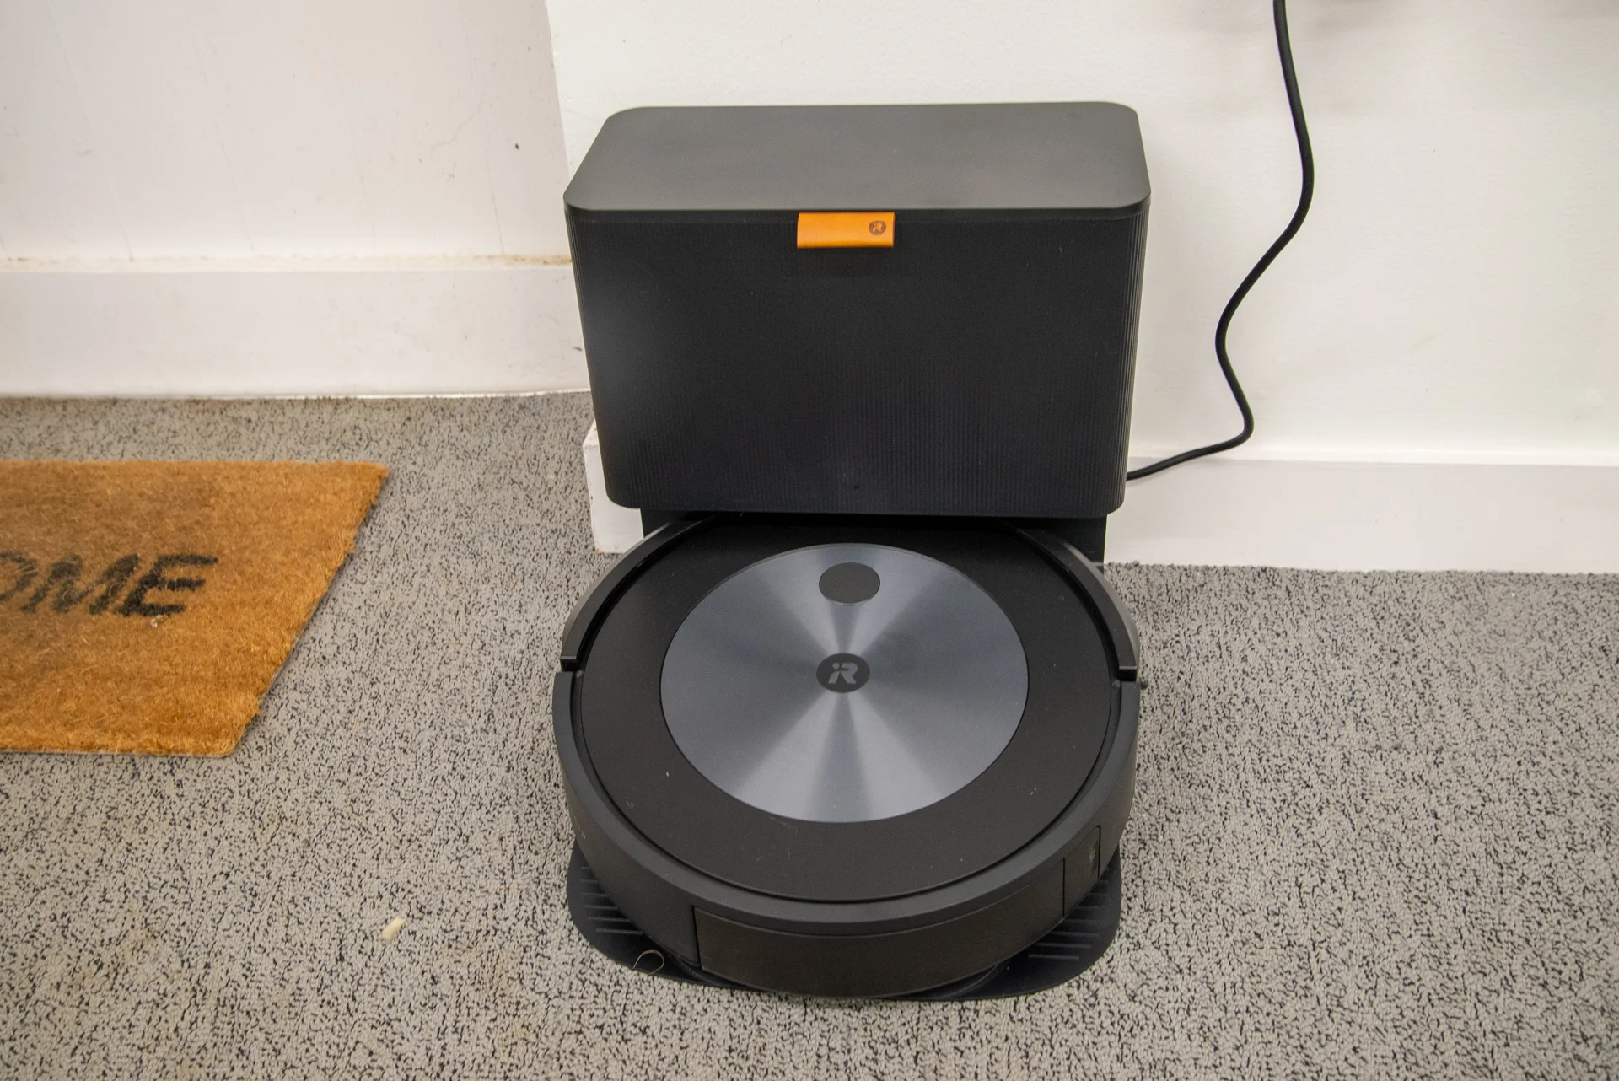

Background Information
What is being proposed?
Iteration on Roomba (Floor cleaning robot) robot design
Designed to clean dust and other light garbage from a single room.
Changes to original design:
Using cheap parts (Affordable)
Robot scents air while cleaning floor
Inspiration:
https://github.com/saiyam-agrawal/Floor-Cleaning-Robot-v2

Slide 3
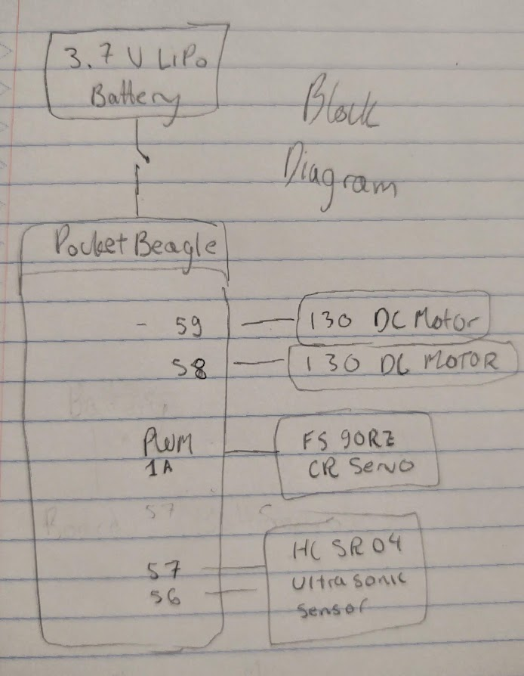
System Block Diagram

Slide 4
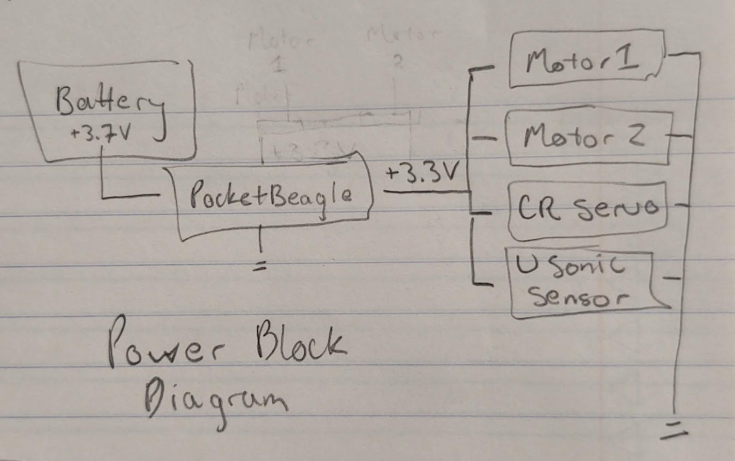
Power Block Diagram

Slide 5
Components / Budget
ITEM | ENGI 301 BUY? | COST
3.7V LiPo Battery | No | $10
PocketBeagle | Already Have | $0
130 DC Motor (x2) | Yes | $4.00
CR Servo | Yes | $5.00
Ultrasonic Sensor | No | $8.00

